Slide 1

Use case identification
Lecture 5

Slide 2
Components of use case model
Use case: Use cases and scenarios describe functionality that describes how actors interact with a system.
Actors: interact directly with a system, and can be humans, systems, or event/time triggers.
  In a banking system, an actor might be a teller who enters banking transactions and a Customer Information System that supplies and maintains customer data.
Associations: These show which use cases an actor can initiate and which actors a use case can access. The line between an actor and its associated use cases depict the associations.

Slide 3
What a use case not used for?
You should NOT use a “Use case diagram” (UCDs) to represent exception behavior (when errors happen) or to try to illustrate the sequence of steps that must be performed in order to complete a task.
A UCD would be poorly suited to describing the TCP/IP network protocol, because there are many exception cases, branching behaviors, and conditional functionality.

Slide 4
Identifying “actors”
An actor can be system’s stakeholders which directly interact with system.
  The most obvious candidates for actors are the humans in the system.
  Any other software from which our system is interacting.
  External Companies.
Identifying “Use cases (UC)”
See what is the functionality of the given system, all functions will be use cases.
  The most obvious candidates for use cases are the Verb in the scenario. Eg; PRINT, IDENTIFY, MATCH, GENERATE REPORT, SHOW RESULTS, RING ALARM, etc…
  Create, Read, Update, Delete (CRUD) are very general examples of UC.

Slide 5
Identifying use case relations types ”stereotypes”
Extend Dependencies :An extend dependency is a generalization relationship where an extending use case continues the behavior of a base use case.
  The extending use case accomplishes this by conceptually inserting additional action sequences into the base use-case sequence.
  When to use <<extends>> : A good rule of thumb is you should introduce an extending use case whenever you have an alternate course of the base use case.
  Include Dependencies : It is a generalization relationship denoting the inclusion of the behavior described by another use case. The best way to think of an include dependency is that it is the invocation(request) of a use case by another one. Example: “Take admission” UC needs to extend a UC “Conduct Medical exam” and “Verify degrees”.

Slide 6
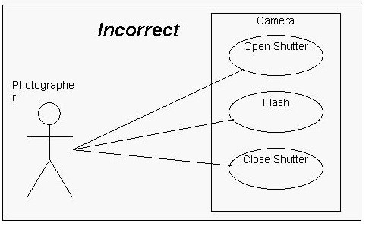
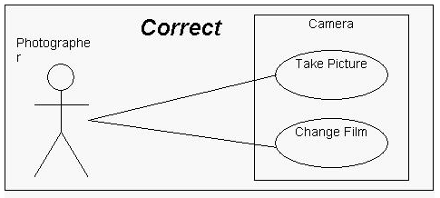
Example 1: uc for camera
Not functions of a camera. Rather than, they are steps taken to perform a UC.

Slide 7
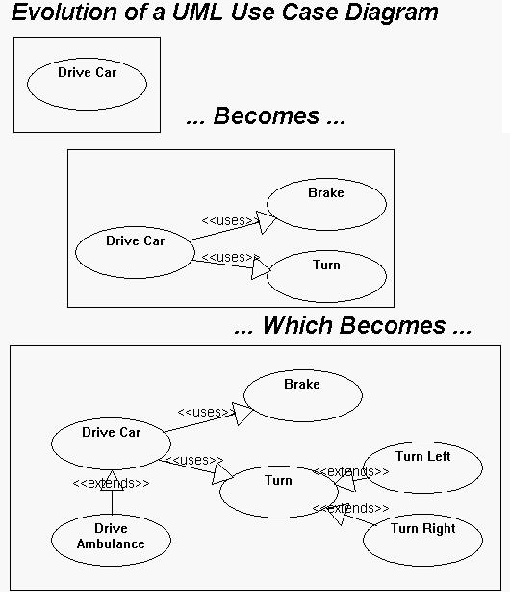
Evolution of use case model

Slide 8
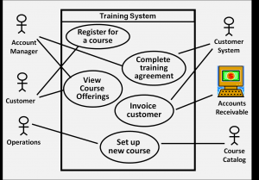
Example 2: online training system

Slide 9
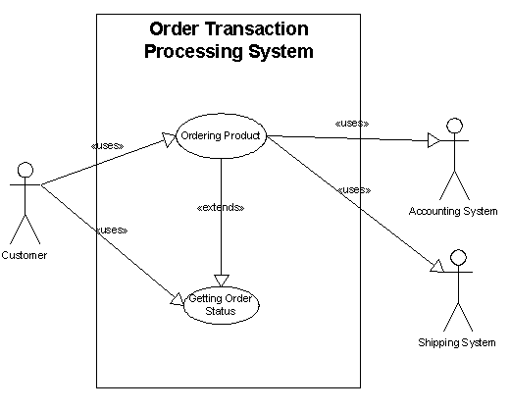
Example 3: order processing system

Slide 10

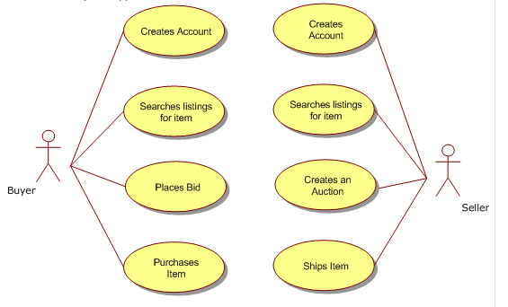
Tips for writing use cases
1. Define your use case actors.
2. Define your “Sunny Day”/ normal Use Cases first and alternative flow use cases secondly.

Slide 11
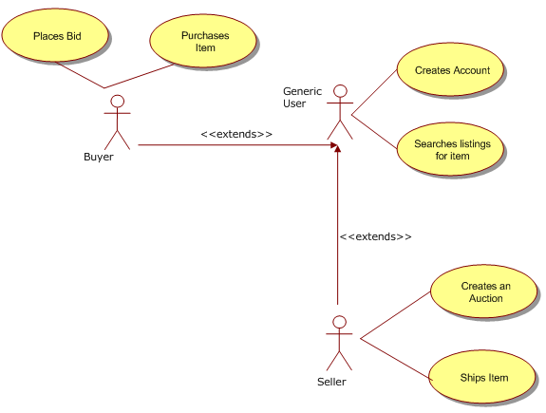
Tips for writing use cases
3. Identify reuse opportunity for use cases (by defining nature of use cases).

Slide 12
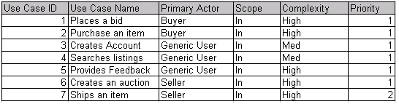
Tips for writing use cases
4. Create a use case index(give a unique id number to every use case, maintain a table).
This use case index should be used by the project team to define the use cases against. It will serve as a master inventory to help writ effective use cases for the requirements phase of the project

Slide 13
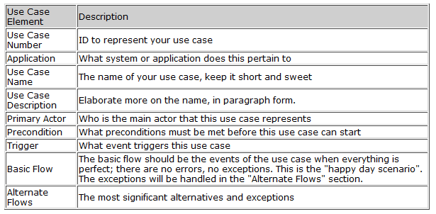
Tips for writing use cases
5. Identify the key components of your use case (name, id, description, actors, etc).
NOTE: This template is given in book of Craig Larman. See more details from there.

Slide 14
Assignment # 1
  NOTE: Its individual submission, complete your task and submit it in next class.
Given Scenario:
There is need to design a Digital Library. Users should be able to access the digital library database. They can search and view available books and articles by entering a ISBN number of book. They can order a copy of book. System will provide a copyright form to user, after user fills the form, copyright form is checked and, if OK, the PDF version of the article is downloaded. Books requested to order will be checked for price and Payments can only be made via credit cards.
To do
  Identify all actors for this problem.
  Identify use cases.
  Create use case index.
  Draw use case model

